Slide 1
Title 1 & Curriculum Presentation
8/26/24
Century Oaks Elementary School

Slide 2
Tonight’s Sessions:
1st Session Tonight will be from 6-6:30PM
2nd Session will be from 6:35-7:00 PM

Slide 3
Title 1 Presentation
01
Support for economically disadvantaged population
Funds used for instructional activities
Parental involvement opportunities

Slide 4
Academic Assessments used to Measure Student Progress
Letter ID and Letter Sound Testing (Grade Appropriate)
F&P Testing
ISIP (Taken the 1st of the Month)
Sistema De Evaluación de La Lectura
IReady Universal Testing in Reading and Math (Coming in November) will be done 3x a year
Illinois Assessment of Readiness (IAR) for Grades 3-6
ACCESS testing for our ELL students
Las Links
Teacher Observations
Progress Monitoring

Slide 5
Working to Support All Students!
Ongoing progress monitoring to support all students by providing skill based interventions to support areas of deficit.
As well as providing areas of enrichment work for students who are performing above grade level in skill areas.

Slide 6
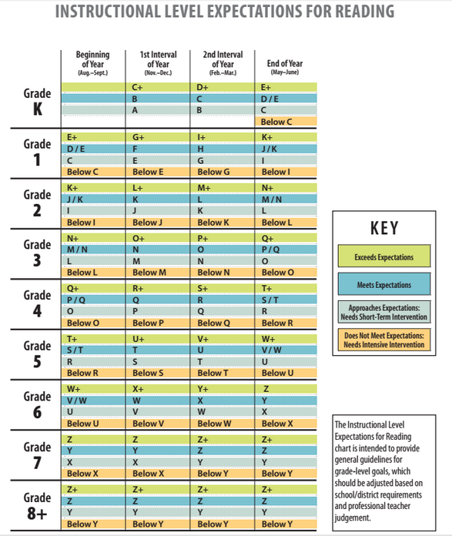
F&P Visual

Slide 7
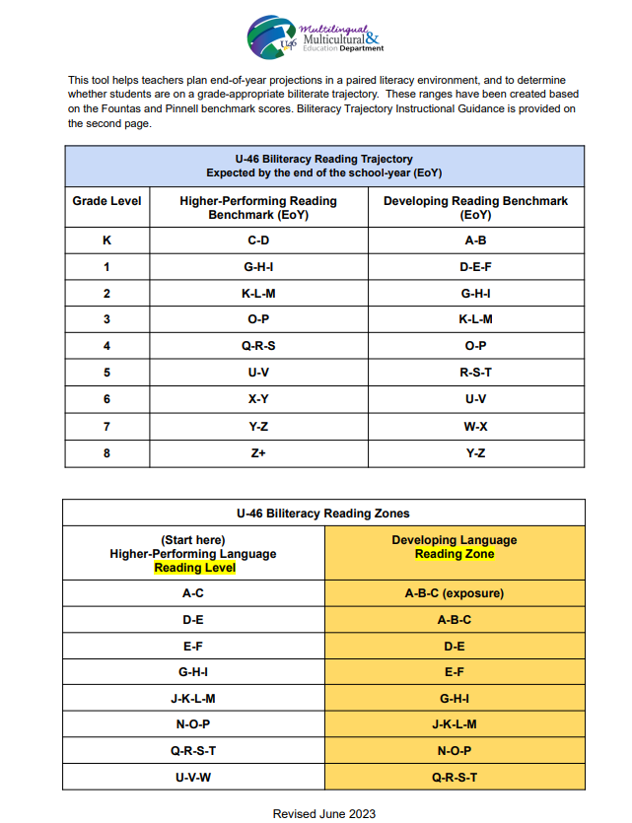
Biliteracy Trajectory Visual

Slide 8
Our Parental Involvement Policy & Parental Rights
Expectation 1:
Expectation 2:
That parents play an active role in assisting their child’s learning
That parents are encouraged to be actively involved in their child’s education at school
Expectation 3:
Expectation 4:
That parents are full partners in their child’s education
The full policy can be found at
https://www.u-46.org/Page/18574

Slide 9
Budget for Planned Parent Activities
PTO Meetings
Curriculum Night
Literacy Night
Book Fairs
Parent Teacher Conferences
… and more!

Slide 10
Early Intervention
+
Parent Support
=
Student Success!

Slide 11
Teacher-Student-Parent Compact
Teacher/Staff
Student:
Family/Parents:
It is important that all students achieve and learn. As a Century Oaks staff member, I will strive to:
As a Century Oaks student, I share the responsibility to improve my academic achievement and achieve the State’s high standards. I will strive to:
As a parent/guardian, I want my child to achieve and learn, therefore, I will support our children’s learning in the following ways:

Slide 12
Updated District Attendance Guidance
Click Here for English Power Point
Click Here for Spanish Power Point

Slide 13
Curriculum Expectations

Slide 14
We are excited to announce….
Students will have Health this year and Science taught by a separate Science teacher!

Slide 15
Additional Curriculum Expectations will be discussed by your child’s teacher…

Slide 16
Thank you!
Do you have any questions?
Please make sure you follow us on Facebook and Class Dojo!

